Slide 1

How to Pull Invoices in FMAnywhere

Slide 2
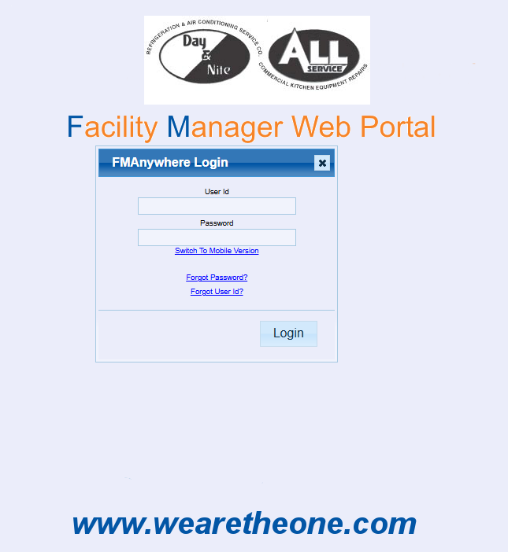
Step 1: Log on to the FMAnywhere Portal https://sampro.wearetheone.com/DBAnalytics/FMAnywhere/FMAnywhere.aspx

Slide 3
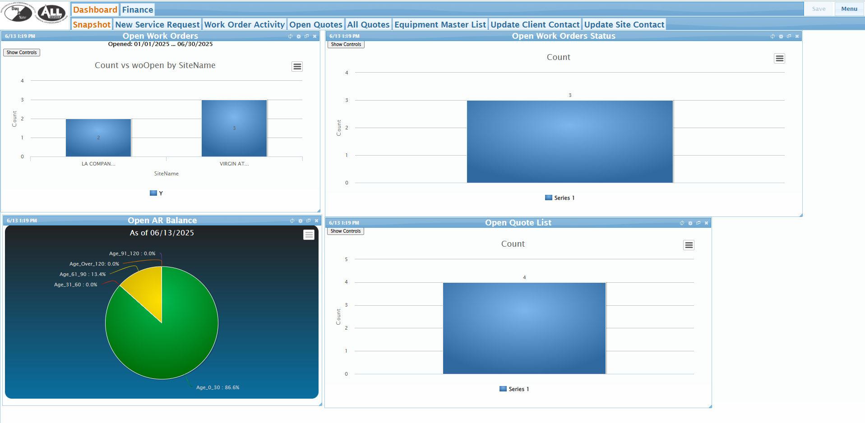
Step Two: Click on the Finance Tab

Slide 4
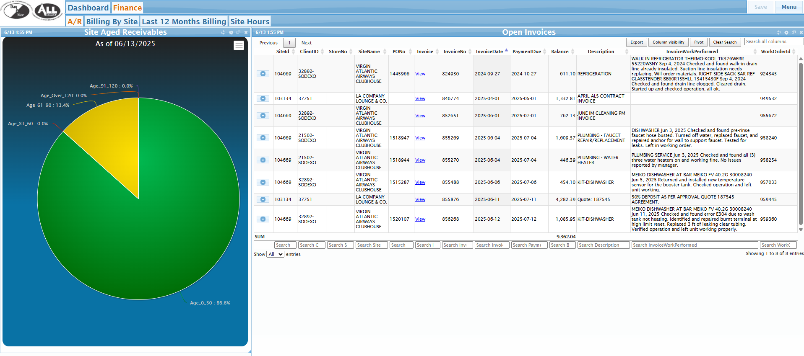
Step 3: Click on the “View” Hyperlink under the “Invoice” Column to Download

Slide 5
FOR ANY ADDITIONAL ASSISTANCE CONTACT clientconcierge@wearetheone.com

