Slide 1

How to Pull Open Quotes on FMAnywhere

Slide 2
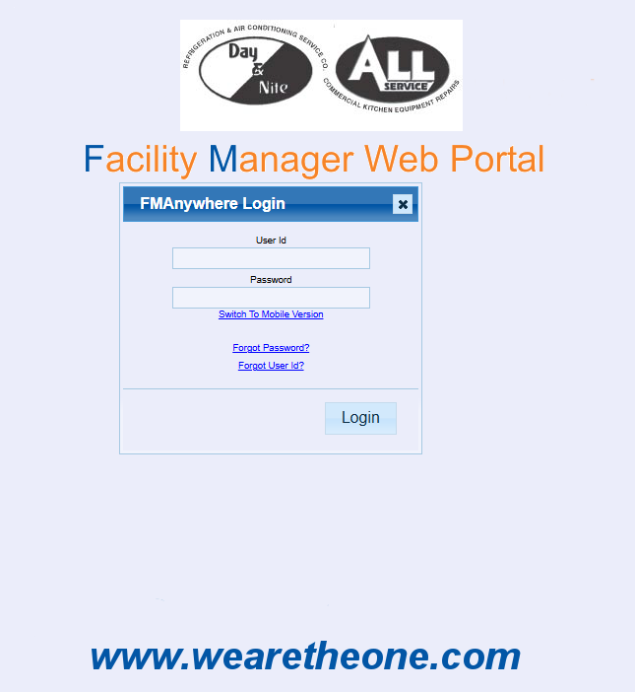
Step One: Log on to the FMAnywhere Portal https://sampro.wearetheone.com/DBAnalytics/FMAnywhere/FMAnywhere.aspx

Slide 3
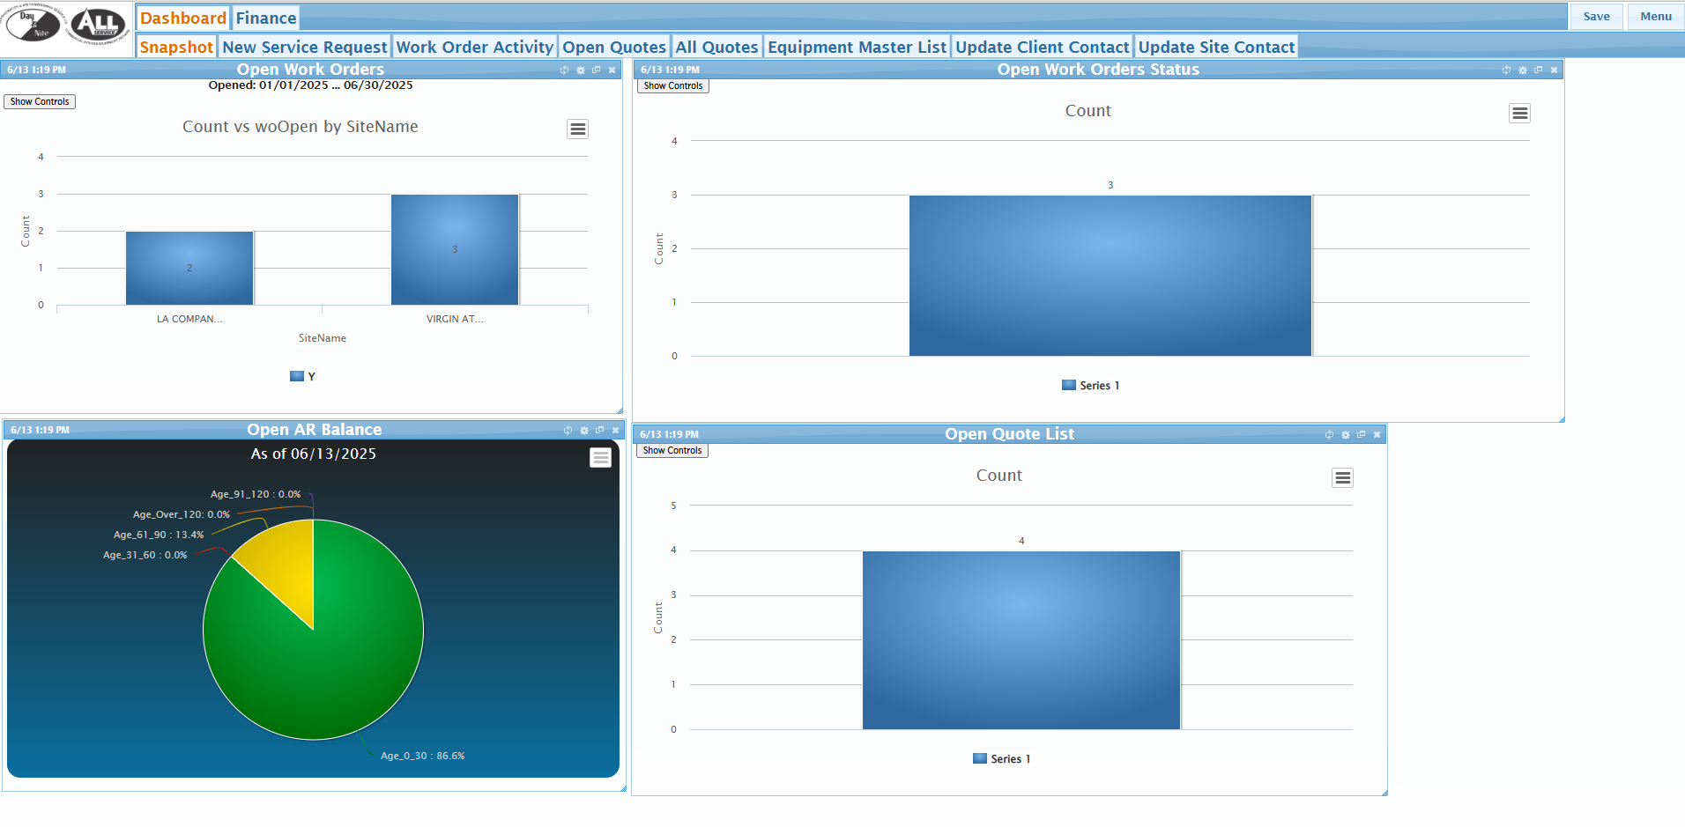
Step Two: Click on the Open Quotes Tab

Slide 4
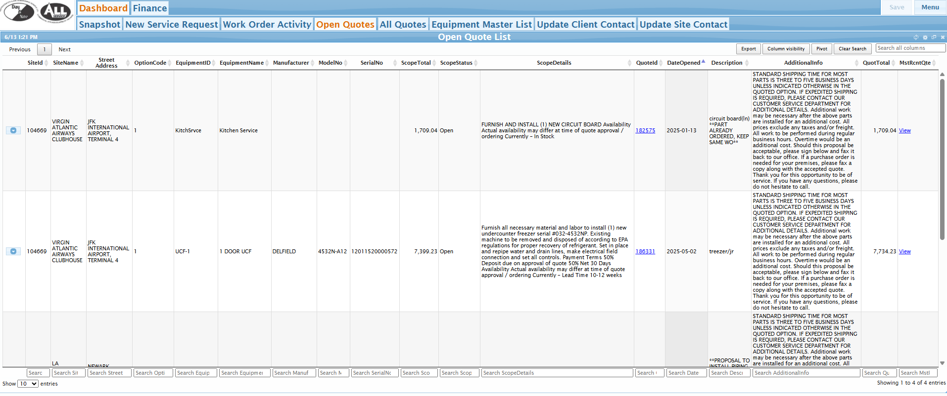
Step Three: Click on the “View” Hyper Link in the “MstRcntQte” Column to download

Slide 5
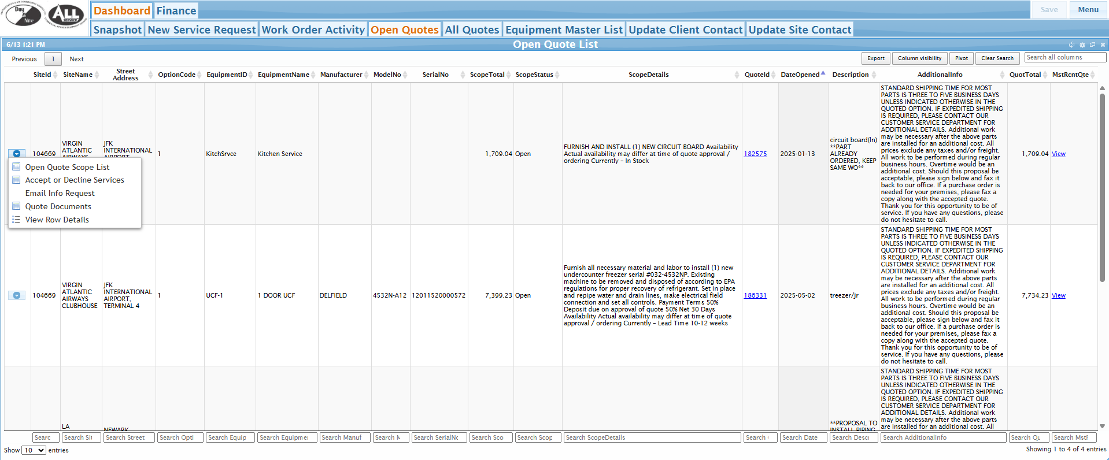
Optional Step: To Approve Quotes in FMAnywhere Click the Dropdown Arrow on the left and select “Accept or Decline Services”

Slide 6
FOR ANY ADDITIONAL ASSISTANCE CONTACT clientconcierge@wearetheone.com

