Slide 1

How to Submit Service Requests on FMAnywhere

Slide 2
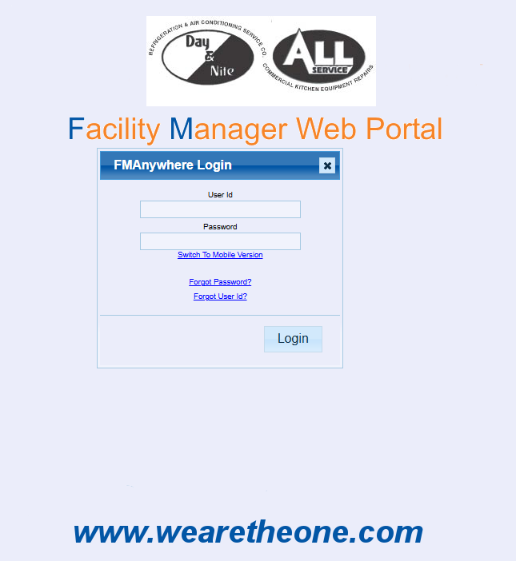
Step 1: Log on to the FMAnywhere Portal https://sampro.wearetheone.com/DBAnalytics/FMAnywhere/FMAnywhere.aspx

Slide 3
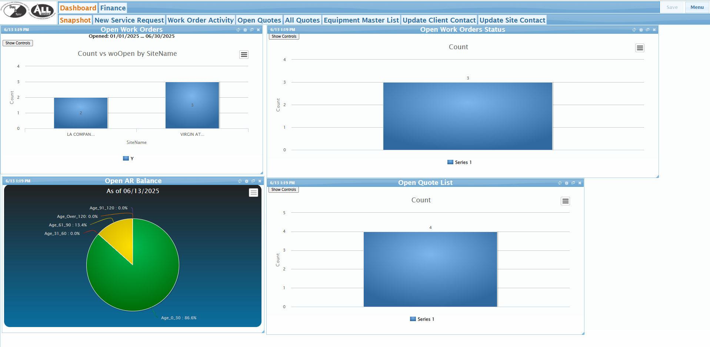
Step Two: Click on the New Service Request Tab

Slide 4
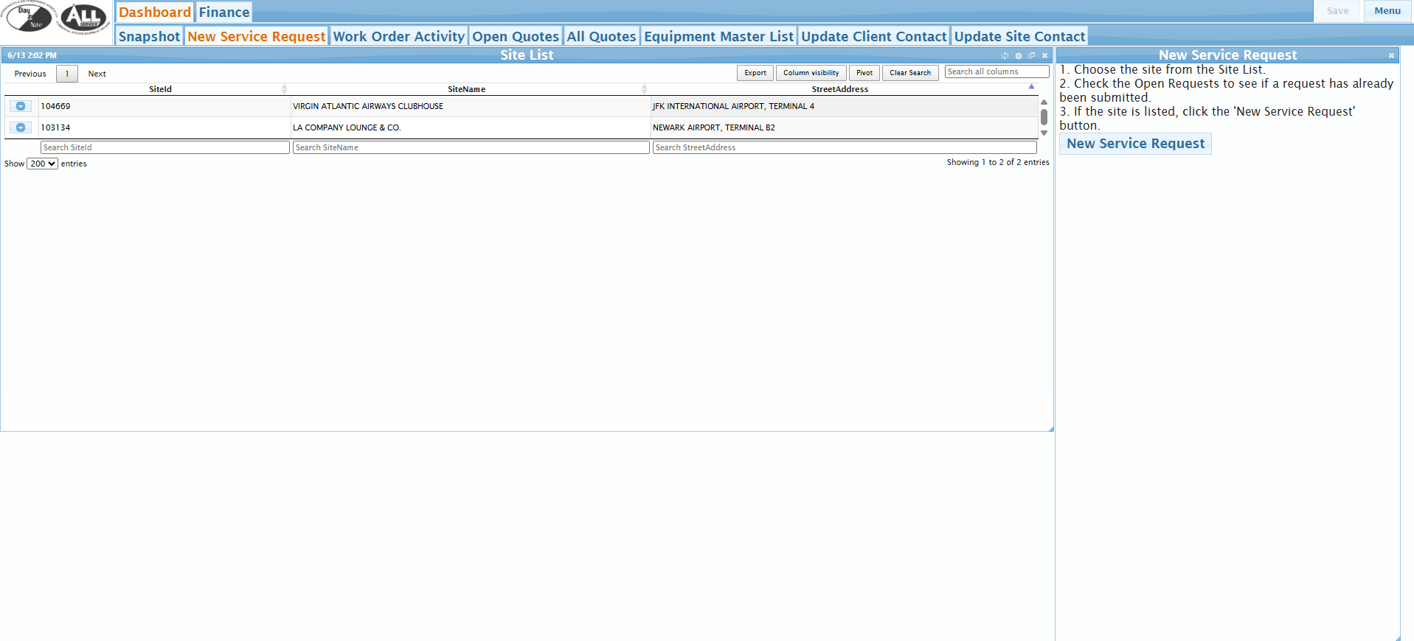
Step Three: Select the site that you want to submit the service request for and then click “New Service Request” button.

Slide 5
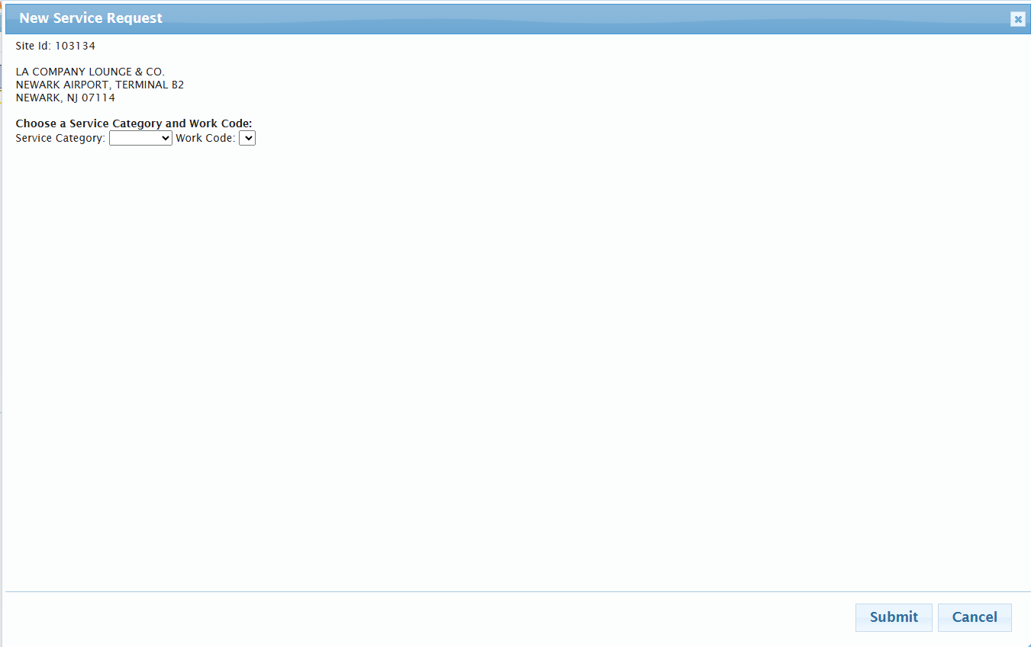
Step Four: Select the Service Category and Work Code

Slide 6
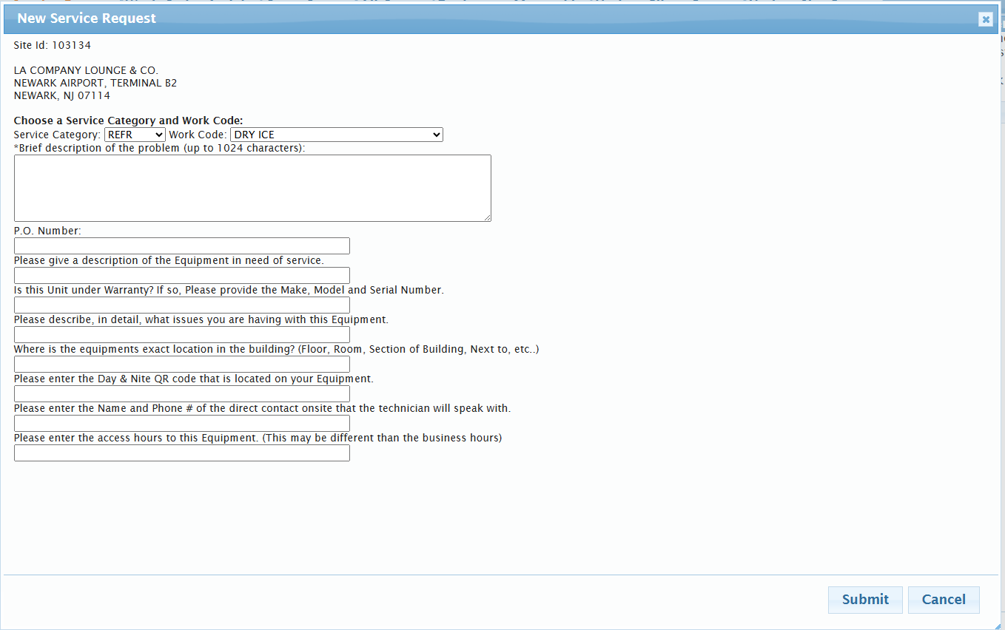
Step Five: Fill Out Form and Click “Submit”.
Please fill out the Description form with as much detail as possible so the technician can arrive with proper parts to conduct repair.

Slide 7
FOR ANY ADDITIONAL ASSISTANCE CONTACT clientconcierge@wearetheone.com

